Slide 1
Today’s Agenda
  Previous class review (refresher)
    Network Security
      How to measure the efficient of an attack detector!
      ROC Analysis
  Today’s Class
    Term Paper Refresher
    Anomaly Detection Problem
    Base Rate Fallacy
    ARP
    ICMP
    PING

Slide 2
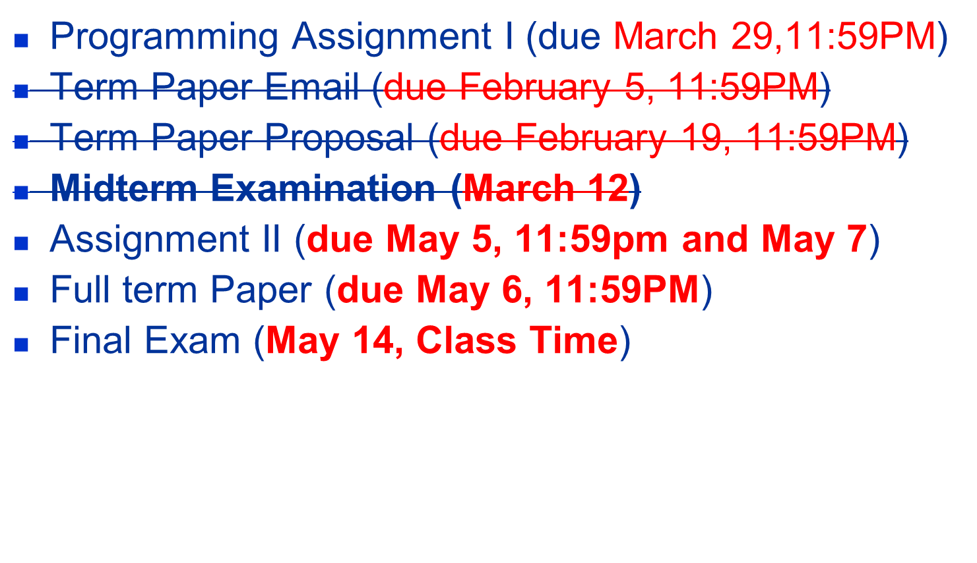
Due Dates
Notes:
The University of Adelaide, School of Computer Science
Chapter 2 — Instructions: Language of the Computer

Slide 3
Term Paper Refresher
Deadline
  May 6, 2015
Page limit
  Not less than 5 pages (single column and 11-12 point Times font)
  Not more than 6 pages (single column and 11-12 point Times font)
  Cover page and table of contents do not count towards the page limit
  Bibliography/references do not count towards the page limit
Sectioning and sub sectioning
  Use the section guidelines in the proposal
  Points for each section (criteria) are same as the proposal
  Proposal guidelines are posted on the Blackboard under Class 1

Slide 4
Previous Class

Slide 5
THRESHOLD???

Slide 6
DESIGN QUESTION 1
SIGNATURE, SIGNATURE, SIGNATURE
  Remember SYN Flooding
  How do you detect SYN Flooding
  HOST – System calls, CPU cycles, memory usage, resource usage, interrupts, TCP/IP stack characteristics, versions, etc.
  NETWORK – Packet counts, aggregate statistics (e.g., # unique IP addresses connecting to a server at time t)

Slide 7
EVALUATION OF SIGNATURES
METRICS
  Detection Accuracy
  False Alarm Rate
  Detection Latency
IS THERE A SYSTEMATIC WAY TO MEASURE TRADE-OFF BETWEEN METRICS?

Slide 8
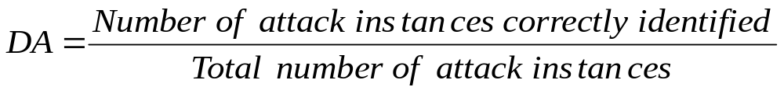
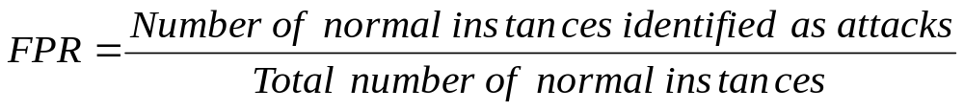
EVALUATION OF SIGNATURES
Measures of Performance
Detection Accuracy (DA)
False Positive Rate (FPR)

Slide 9
Receiver Operating Characteristic (ROC) Curve
Area Under ROC Curve (AUC)
(1,0)
(1,1)
I
II
III
Detection Accuracy
ROC Curves
(0,0)
(0,1)
False Positive Rate

Slide 10
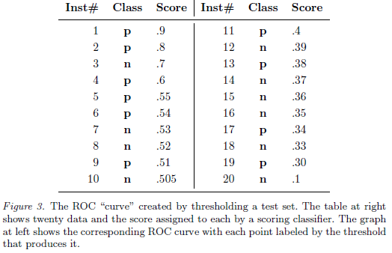

Slide 11
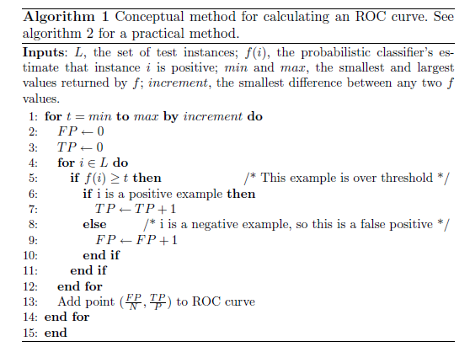

Slide 12
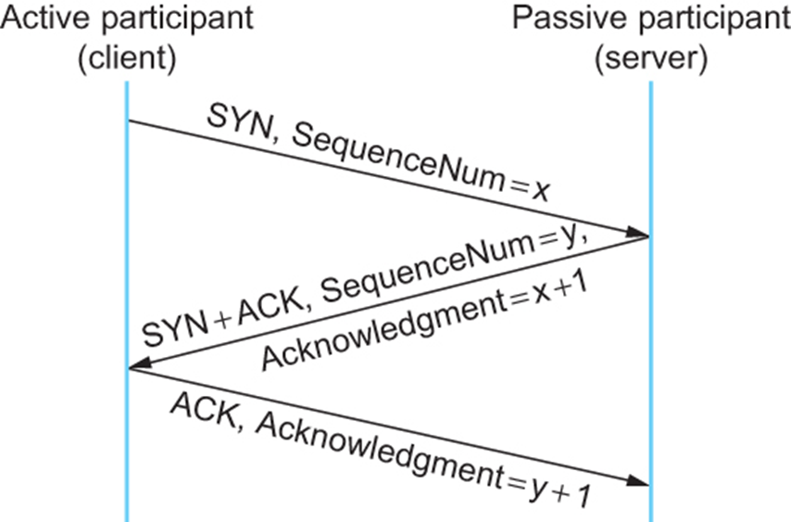
SEQUENCE NUMBER PREDICTION
C→S: SYN (ISNc)
S →C: SYN (ISNs),ACK (ISNc)
C→S: ACK (ISNs)
C→S: data and/or
S→C: data

Slide 13
SEQUENCE NUMBER PREDICTION
X→S: SYN (ISNx), SRC = T
S→T: SYN (ISNs), ACK (ISNx)
X→S: ACK (ISNs), SRC = T
X→S: ACK (ISNs), SRC = T, nasty-data

Slide 14
SEQUENCE NUMBER PREDICTION
Explain the sequence number prediction attack on TCP (see ‘Security Problems in the TCP/IP Protocol Suite’ paper). Give detailed steps showing how an attacker might predict the sequence numbers of a server.
Assume the following:
The server increments the sequence number (SN) every second by 10;
At the start (boot) time, t = 0 and SN = 0;
At t = 1, SN = 10, at t = 2, SN = 20, at t = 3, SN = 30, and so on (because the server increments SN by 10 every second); and
The round-trip time between the attacker’s computer and the server is exactly 0.5 second.
Feel free to make reasonable assumptions to answer this question. State your assumptions.

Slide 15
C→S:SIN (ISNc)
S →C:SYN (ISNs), ACK (ISNc)
C→S:ACK (ISNs)
C→S:data
and/or
S→C:data

Slide 16
X→S:SYN (ISNx),SRC =T
S→T:SYN (ISNs),ACK (ISNx)
X→S:ACK (ISNs),SRC =T
X→S:ACK (ISNs),SRC =T, nasty-data

Slide 17
Today’s Lecture

Slide 18
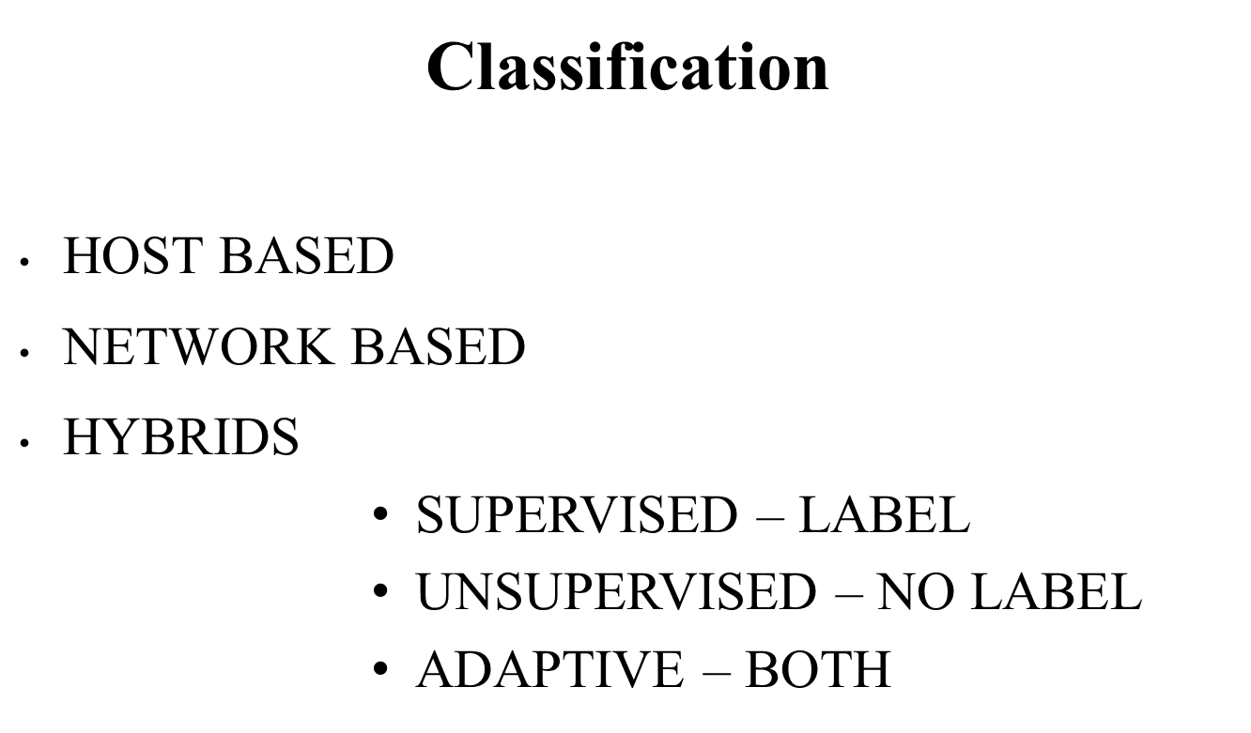
INTRUSION DETECTION

Slide 19
DESIGN QUESTION 1
SIGNATURE, SIGNATURE, SIGNATURE
  Remember SYN Flooding
  How do you detect SYN Flooding
  HOST – System calls, CPU cycles, memory usage, resource usage, interrupts, TCP/IP stack characteristics, versions, etc.
  NETWORK – Packet counts, aggregate statistics (e.g., # unique IP addresses connecting to a server at time t)

Slide 20
DESIGN QUESTION 1 (CONT)
SIGNATURE, SIGNATURE, SIGNATURE
  Remember “Heartbleed” Attack
Oops! We have a ZERO-DAY
What can we do? – Anomaly Detection

Slide 21
Anomaly Detection – A Survey

Slide 22
Base Rate Fallacy Problems
Probability
  Definition
  Coin Example
  Dice Example
Joint Probability
  Coin Example
  Dice Example
Conditional Probability
  Coin Example
  Dice Example
Bayes Theorem

Slide 23
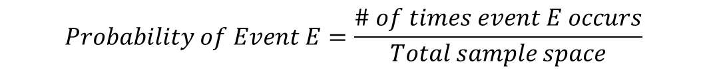
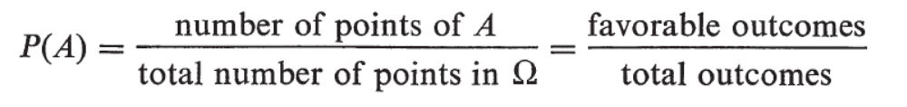

Slide 24
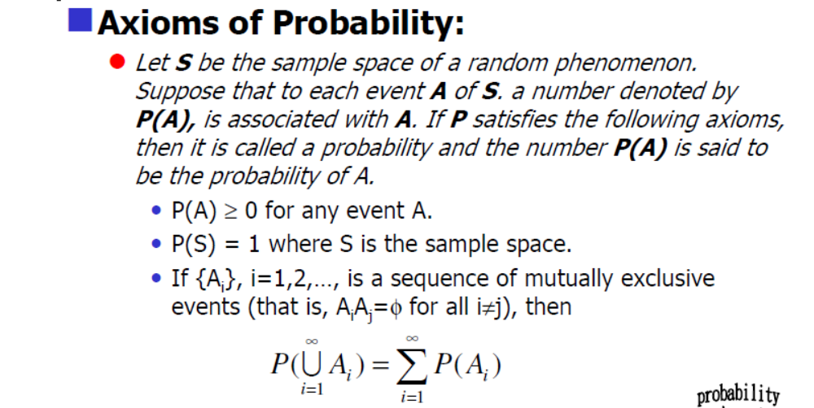

Slide 25
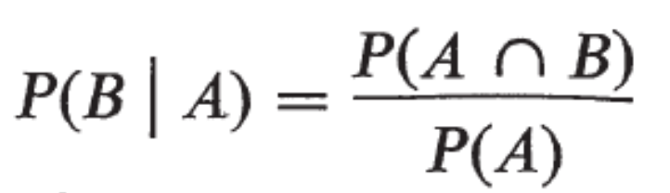
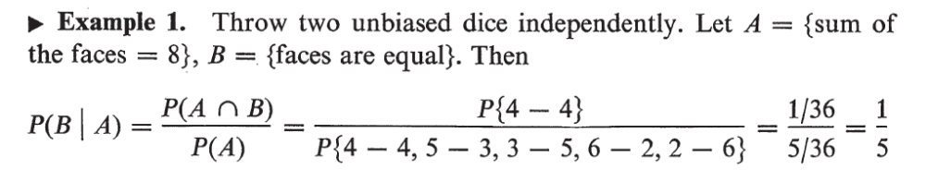
Joint Probability
Conditional Probability

Slide 26
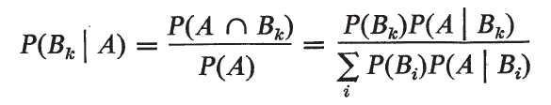
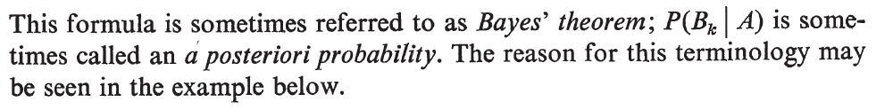
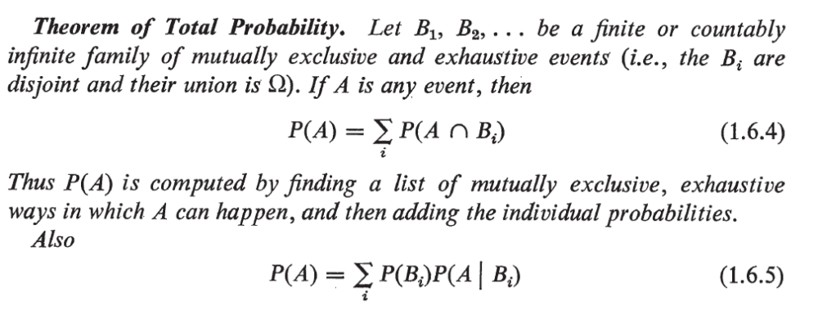

Slide 27
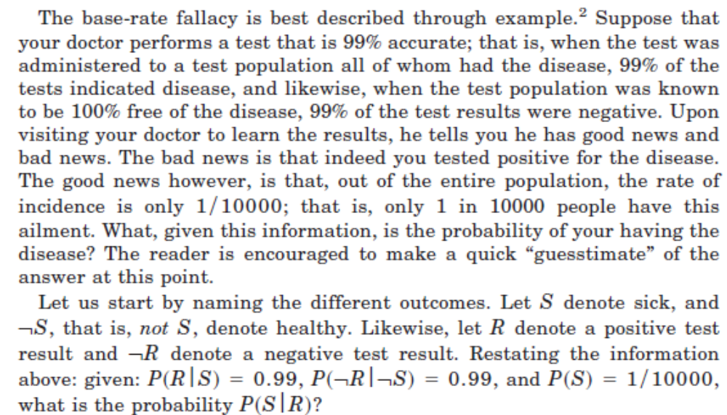

Slide 28
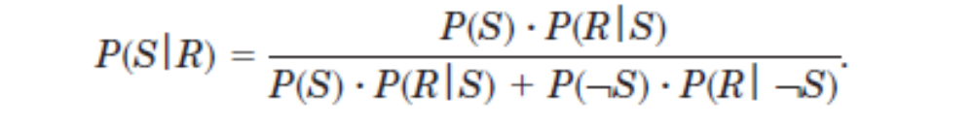

Slide 29
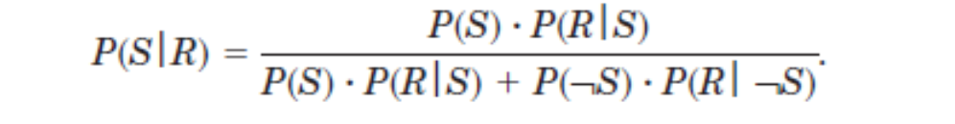
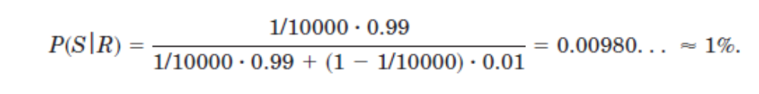

Slide 30
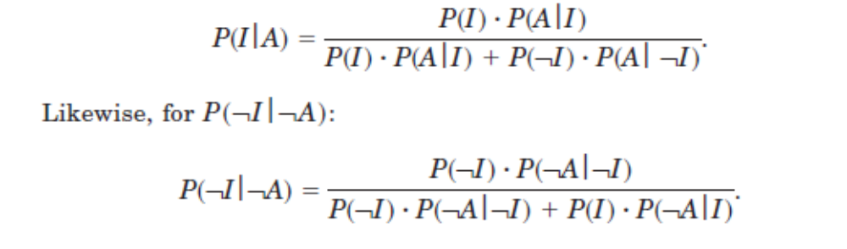

Slide 31
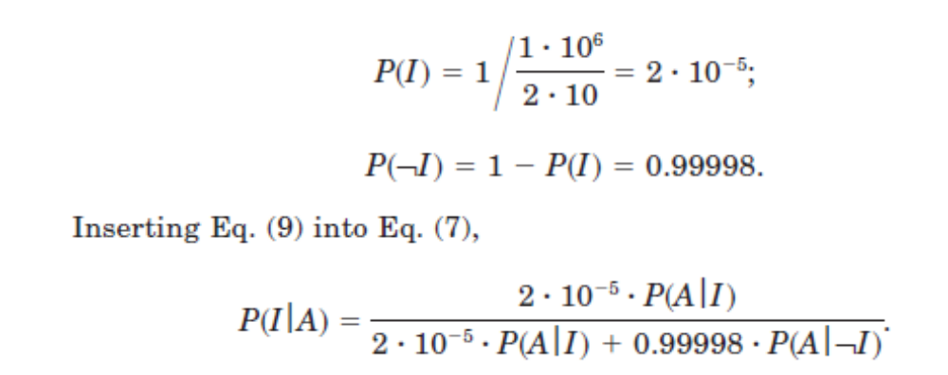

Slide 33
THE END

